Slide 1


KALLAM HARANADHAREDDY INSTITUTE OF TECHNOLOGY (Autonomous) Chowdavaram, Guntur Dt. Amaravathi , Andhra Pradesh Affiliated to jntuk , approved by aicte , New Delhi
Long Term Internship & Project Presentation
0n
Amazon web services
&
Smart waste management system
Team Members :K. Vennela (218x1a0434)
K. Udaya Sri(218x1a0442)
K. Avinash(218x1a0432)
K. Murali Manohara joshi(218x1a0422)
Mentored By: Mr. T. Ravi kanth (M.Tech)
Associate Professor

Slide 2
CONTENTS
Introduction
Internship Overview
Modules Of Internship
Internship Outcomes
Project Overview
Components(Hardware & Software)
Working
Conclusion
Output Screens

Slide 3

INTRODUCTION
Name of the Training Partner : SMART BRIDGE
Name of the Track : AWS (Cloud Practitioner)
Smart Bridge provides Industry relevant Internships and trainings.
Collaboration with AWS for cloud certifications.
AWS cloud practitioner long term Internship powered by SmartBridge with a duration of 12 weeks.

Slide 4

INTERNSHIP OVERVIEW
This internship program focuses on AWS Cloud Computing fundamentals and real- world applications.
Covers AWS services , Security , Networking , Cloud Concepts .
Gain hands-on experience with AWS Cloud.
Work on real-world projects using Skill builder Cloud Quest.
Global Certification guidance for AWS Cloud Practitioner.

Slide 5
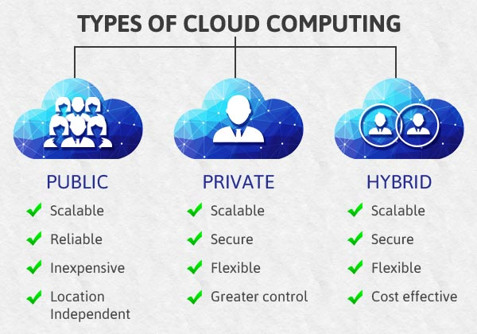
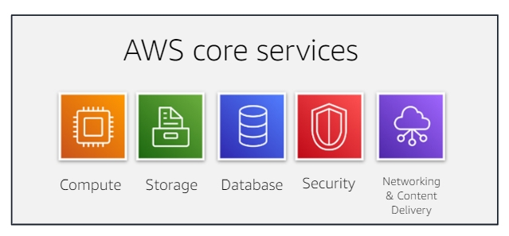
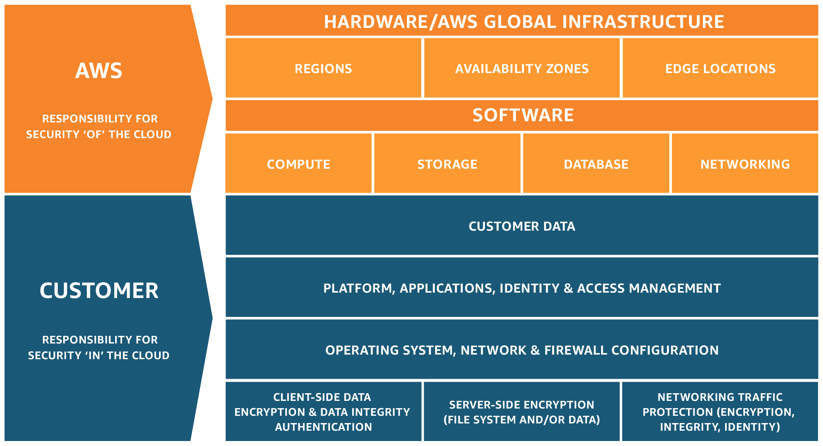
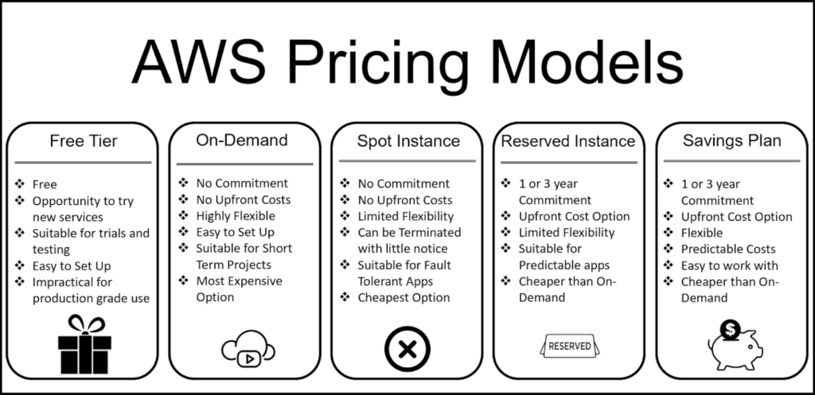
KEY MODULES
Cloud Concepts
AWS core services
Billing and Pricing
Security

Slide 6
INTERNSHIP OUTCOMES
Proficiency in AWS services like EC2 , S3 , RDS , DynamoDB.
Official certification support.
Enhancing cloud security and monitoring strategies.
Career acceleration & job opportunities.

Slide 7
PROJECT OVERVIEW
TITLE : SMART WASTE MANAGEMENT SYSTEM
Problem Statement : To address the challenges of inefficient waste collection and disposal, leading to unsanitary conditions and environmental pollution, by implementing a system that optimizes collection routes, monitors bin fill levels, and promotes proper waste segregation, ultimately improving public health and environmental sustainability.
Key Challenges :
High Initial costs
Waste Segregation
Public Awareness
Data Security and Privacy

Slide 8
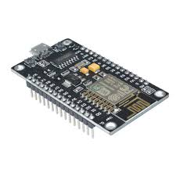
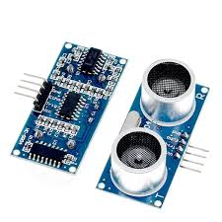
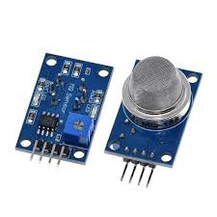
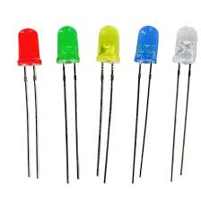
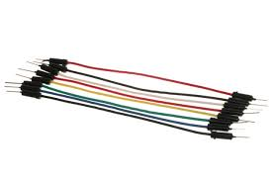
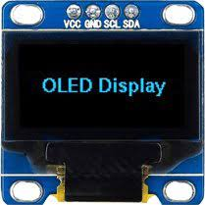
COMPONENTS
Nodemcu esp8266
ultrasonic sensor
mq135
jumper wires
Oled sensor
led

Slide 9
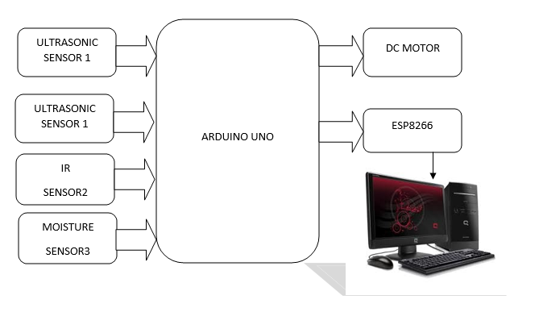
BLOCK DIAGRAM

Slide 10
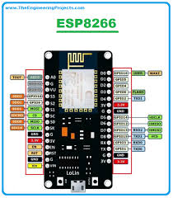
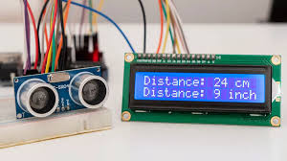
HARDWARE DESCRIPTION
1. NODEMCU ESP8266
NodeMCU provides access to the GPIO (General Purpose Input/Output) and a pin mapping table is part of the API documentation.
The ESP8266 is a system on a chip (SOC) Wi-Fi microchip for Internet of Things (IoT) applications produced by Espressif Systems
2. ULTRASONIC SENSOR
An electronic instrument that uses ultrasonic sound waves (through air) to measure the distance of the target object and the reflected sound is converted into electrical signal.

Slide 11
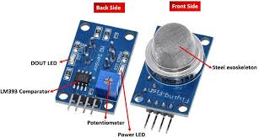

3. MQ 135 Sensor
MQ135 gas sensor has high sensitivity to ammonia gas, sulfide, benzene series steam, also can monitor smoke and other toxic gases well.
It can detect kinds of toxic gases and is a kind of low-cost sensor for kinds of applications.
4. OLED DISPLAY
The acronym ‘OLED’ stands for Organic Light-Emitting Diode. These devices use LED technology and use an organic material as a light emitting layer.
Organic LEDs can produce high quality displays with high contrasts, high viewing angles and true blacks. Some say that OLEDs produce the world’s best display panels.

Slide 12
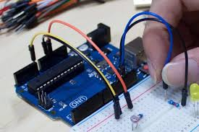
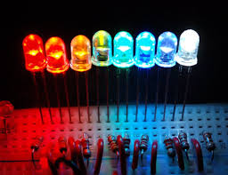
5. JUMPER WIRES
Jumper wires are short, conductive wires with connectors or pins at each end, used to make temporary connections between components in circuits, breadboards, or other prototyping setups, without the need for soldering
6. Light Emitting Diode (LED)
A light-emitting diode (LED) is a semiconductor device that emits light when an electric current flows through it, a process called electroluminescence

Slide 13
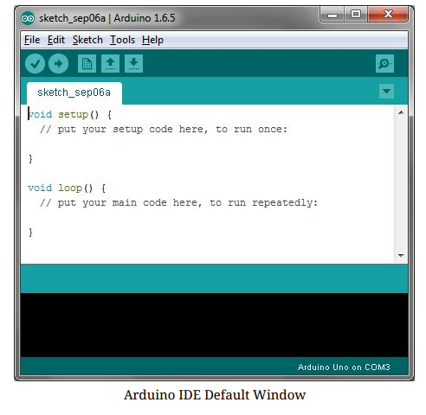
SOFTWARE DESCRIPTION
ARDUINO IDE : It contains a text editor for writing program , a message area , a text console and a series of menu . It connects to the Arduino and hardware to upload programs and communicate with them
Verify :
Checks your code for errors compling it.
Upload :
Complete your code and uploads it to the configured board
New :
Creates a new sketch
Open :
Presents a menu of all the sketches in your sketchbook. Clicking one will open it within the current window overwriting its content.
Save :
Saves your sketch.

Slide 14
WORKING
Data Collection
Fill Level Monitoring: Sensors, often ultrasonic or weight sensors, measure the fullness of bins, enabling real-time tracking of waste levels.
Temperature Monitoring: Sensors can monitor the temperature of waste, particularly important for organic waste, to track decomposition and optimize collection schedules.
2. Processing & Decision Making
Arduino Uno receives data from all sensors.
It compares values with predefined safety limits.
If temperature, fire levels exceed safe limits, it triggers an alert.
3. Safety Actions & Alerts
If a risk is detected, the buzzer sounds an alarm.
The system can be programmed to send alerts to a display or mobile app.
In advanced setups, the system could disconnect power or trigger cooling mechanisms to prevent hazards.

Slide 15
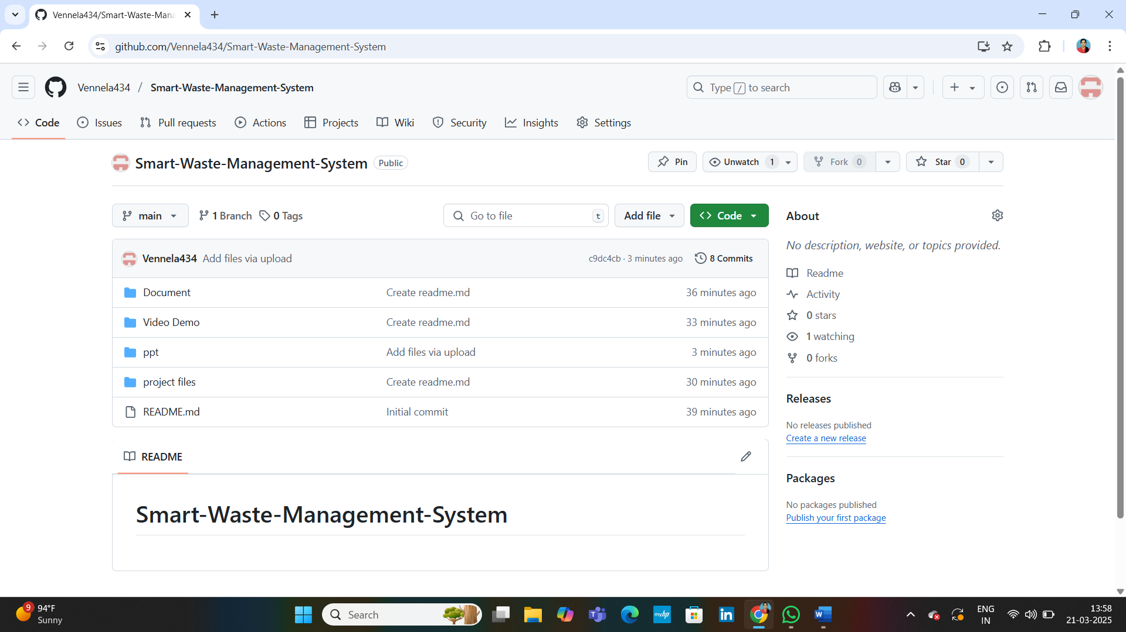
GITHUB LINK: https://github.com/Vennela434/Smart-Waste-Management-System

Slide 16
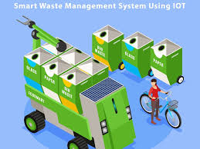
CONCLUSION
Real-time Alerts: The buzzer provides instant warning signals in case of abnormal conditions.
Realiable & Cost-Effective: Uses Arduino-based sensors for an affordable and efficient safety solution.
Integrating IoT into smart waste management systems offers a transformative approach to urban ecology, enabling real-time monitoring, optimized collection routes, and reduced operational costs, ultimately leading to cleaner, healthier, and more sustainable cities.

Slide 17
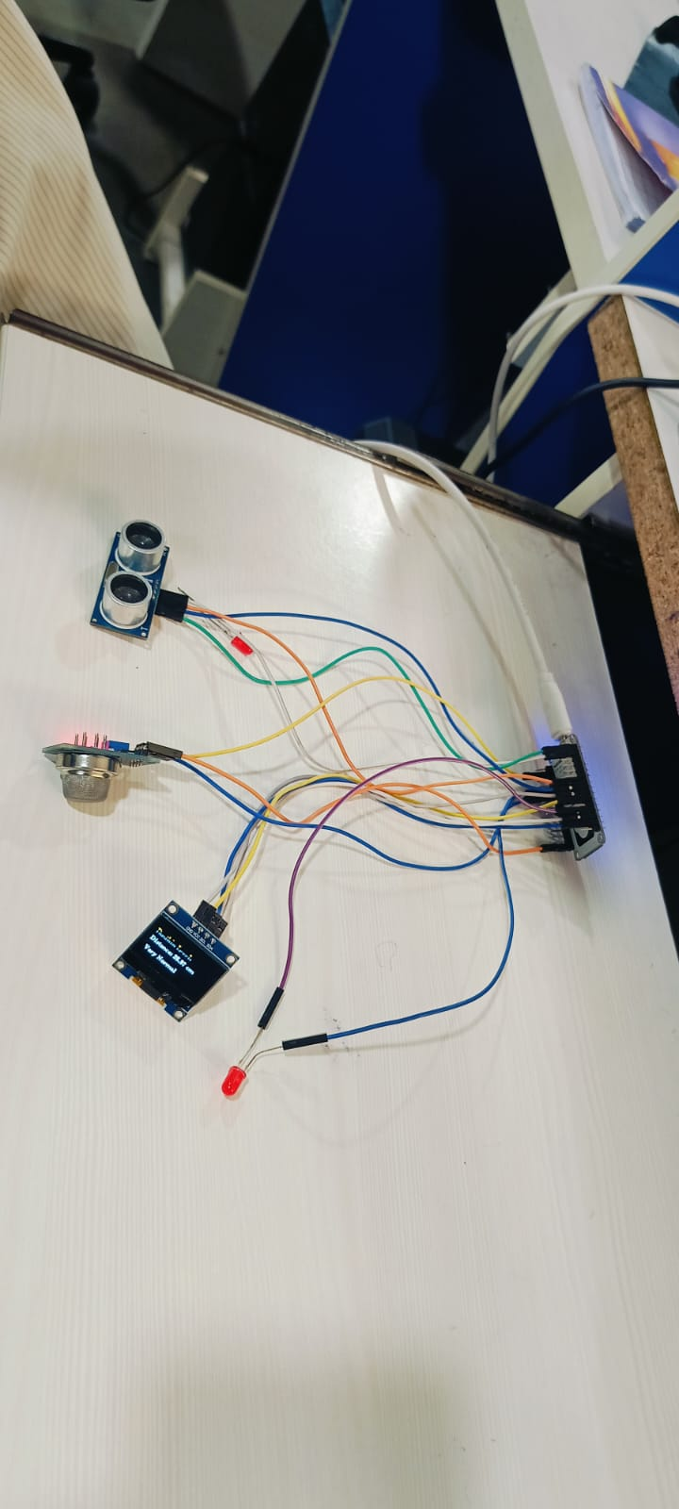
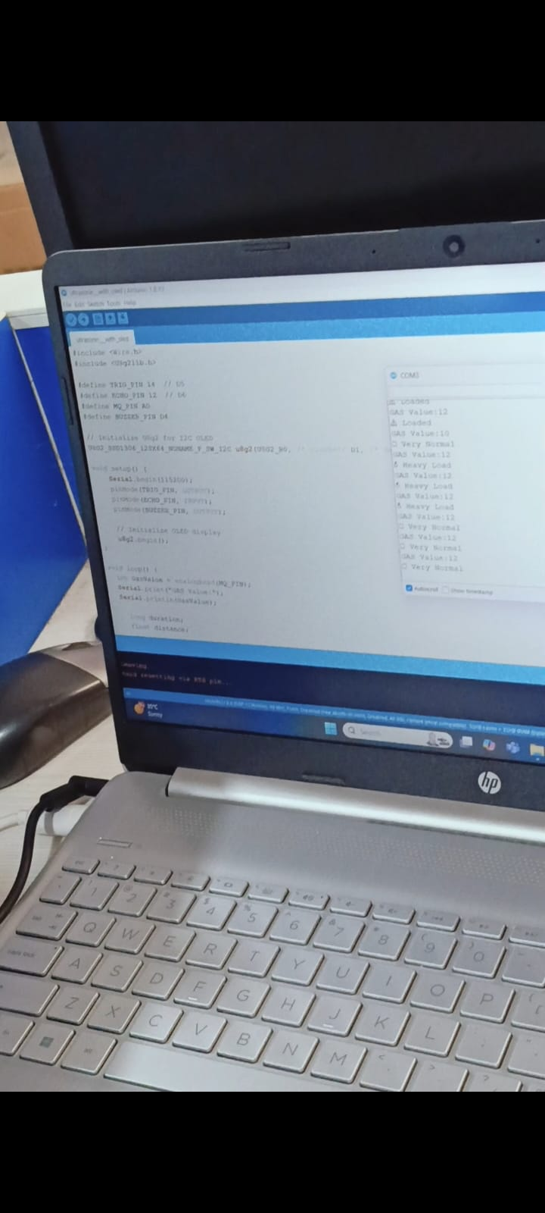
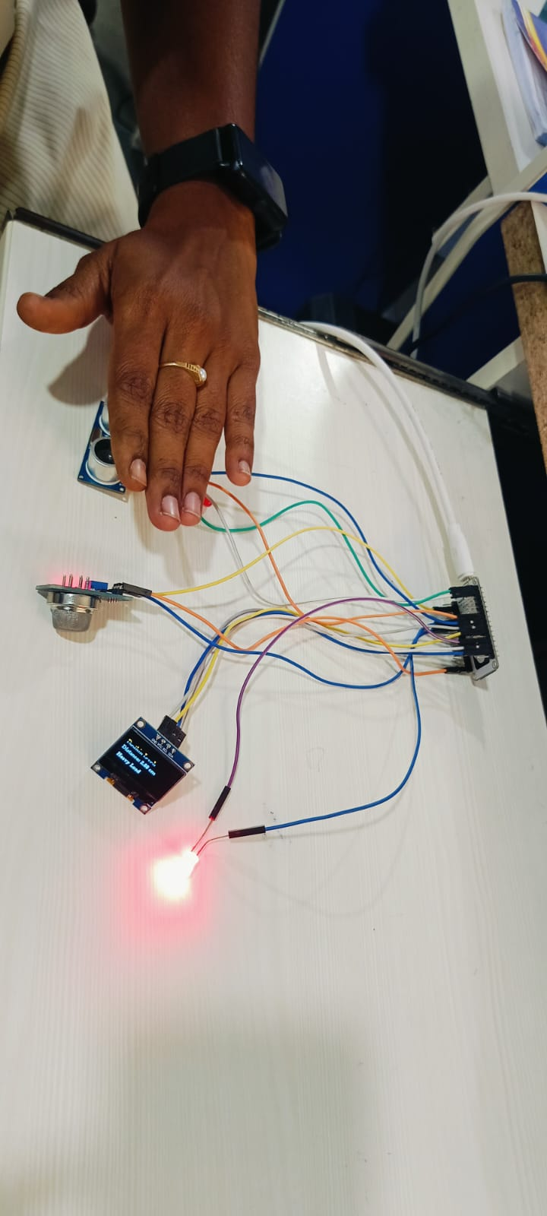
OUTPUT SCREENS

Slide 18


